Slide 1

Mr. Amol Jadhav Assistant Professor Department of Mathematics Vidya Pratishthan’s Kamalnayan Bajaj Institute of Engineering and Technology, Baramati
Subject: Engineering Mathematics-III Topic: Inverse Z-Transform Lecture No.- 06

Slide 2
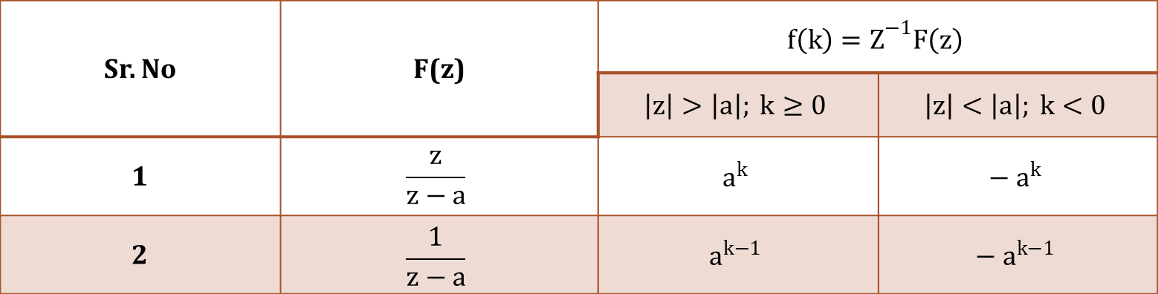
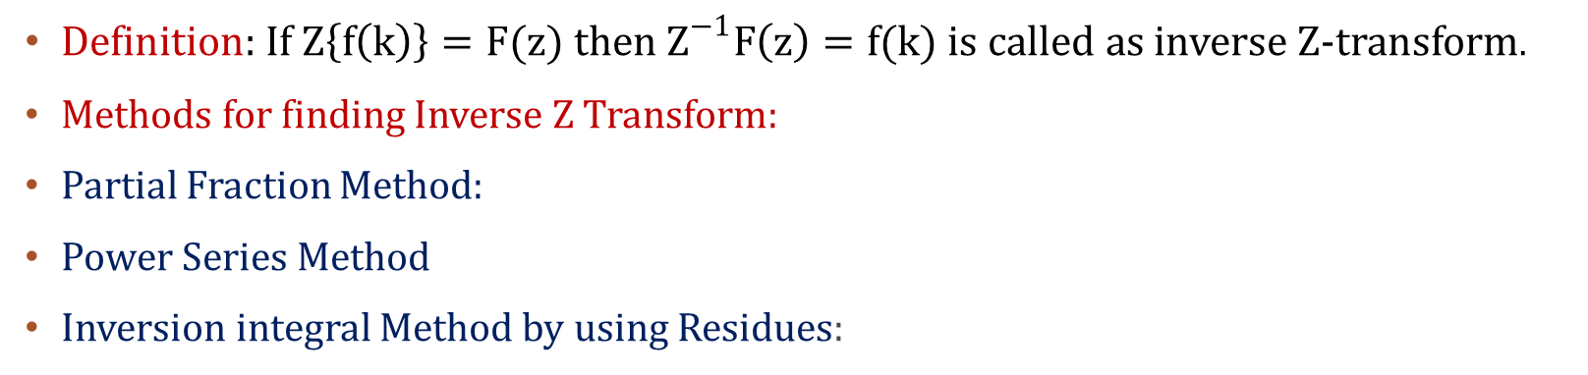
INVERSE Z-Transform
Definition: If $Z\left\{f\left(k\right)\right\}=F(z)$ then $Z^{−1}F\left(z\right)=f(k)$ is called as inverse Z-transform.
Methods for finding Inverse Z Transform:
Partial Fraction Method:
Power Series Method
Inversion integral Method by using Residues:
Table of Inverse Z-transform:
Sr. No | F(z) | $${f\left(k\right)=Z}^{−1}F\left(z\right)$$
 |  | $$\left|z\right|>\left|a\right|; k≥0$$ | $$\left|z\right|<\left|a\right|; k<0$$
1 | $$\frac{z}{z−a}$$ | $$a^{k}$$ | $${− a}^{k}$$
2 | $$\frac{1}{z−a}$$ | $$a^{k−1}$$ | $${− a}^{k−1}$$

Slide 3
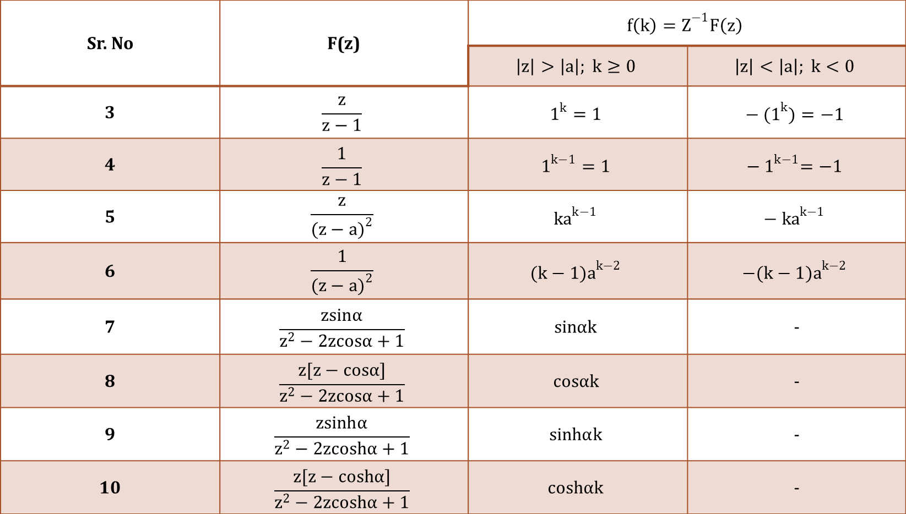
Sr. No | F(z) | $${f\left(k\right)=Z}^{−1}F\left(z\right)$$
 |  | $$\left|z\right|>\left|a\right|; k≥0$$ | $$\left|z\right|<\left|a\right|; k<0$$
3 | $$\frac{z}{z−1}$$ | $$1^{k}=1$$ | $${− (1}^{k})=−1$$
4 | $$\frac{1}{z−1}$$ | $$1^{k−1}=1$$ | $${− 1}^{k−1}=−1$$
5 | $$\frac{z}{{(z−a)}^{2}}$$ | $${ka}^{k−1}$$ | $${− ka}^{k−1}$$
6 | $$\frac{1}{{(z−a)}^{2}}$$ | $${(k−1)a}^{k−2}$$ | $${−(k−1)a}^{k−2}$$
7 | $$\frac{zsinα}{z^{2}−2zcosα+1}$$ | $$sinαk$$ | -
8 | $$\frac{z[z−cosα]}{z^{2}−2zcosα+1}$$ | $$cosαk$$ | -
9 | $$\frac{zsinhα}{z^{2}−2zcoshα+1}$$ | $$sinhαk$$ | -
10 | $$\frac{z[z−coshα]}{z^{2}−2zcoshα+1}$$ | $$coshαk$$ | -

Slide 4
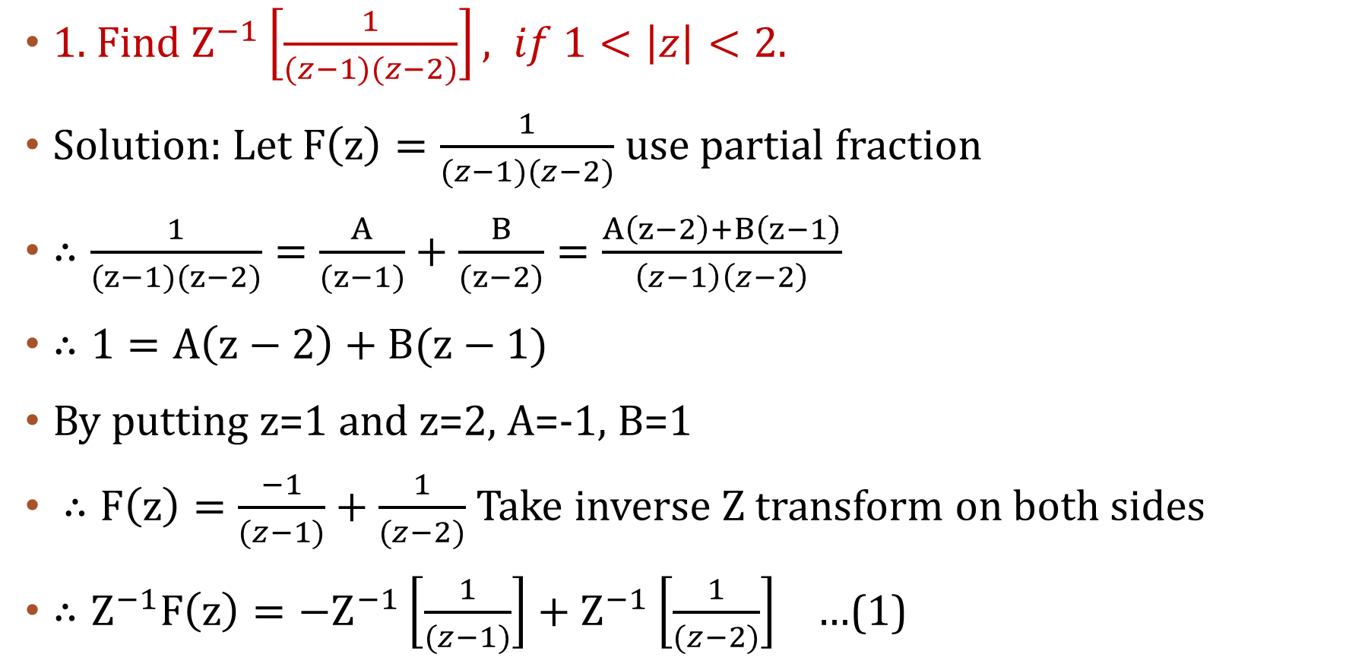
Examples on Method:1. Partial Fraction Method
1. Find $Z^{−1}\left[\frac{1}{(z−1)(z−2)}\right], if 1<\left|z\right|<2.$
Solution: Let $F\left(z\right)=\frac{1}{(z−1)(z−2)}$ use partial fraction
$∴\frac{1}{(z−1)(z−2)}=\frac{A}{(z−1)}+\frac{B}{(z−2)}=\frac{A\left(z−2\right)+B\left(z−1\right)}{\left(z−1\right)\left(z−2\right)}$
$∴1=A\left(z−2\right)+B(z−1)$
By putting z=1 and z=2, A=-1, B=1
$∴F\left(z\right)=\frac{−1}{(z−1)}+\frac{1}{(z−2)}$ Take inverse Z transform on both sides
$∴Z^{−1}F\left(z\right)={−Z}^{−1}\left[\frac{1}{(z−1)}\right]+Z^{−1}\left[\frac{1}{(z−2)}\right]$ …(1)

Slide 5
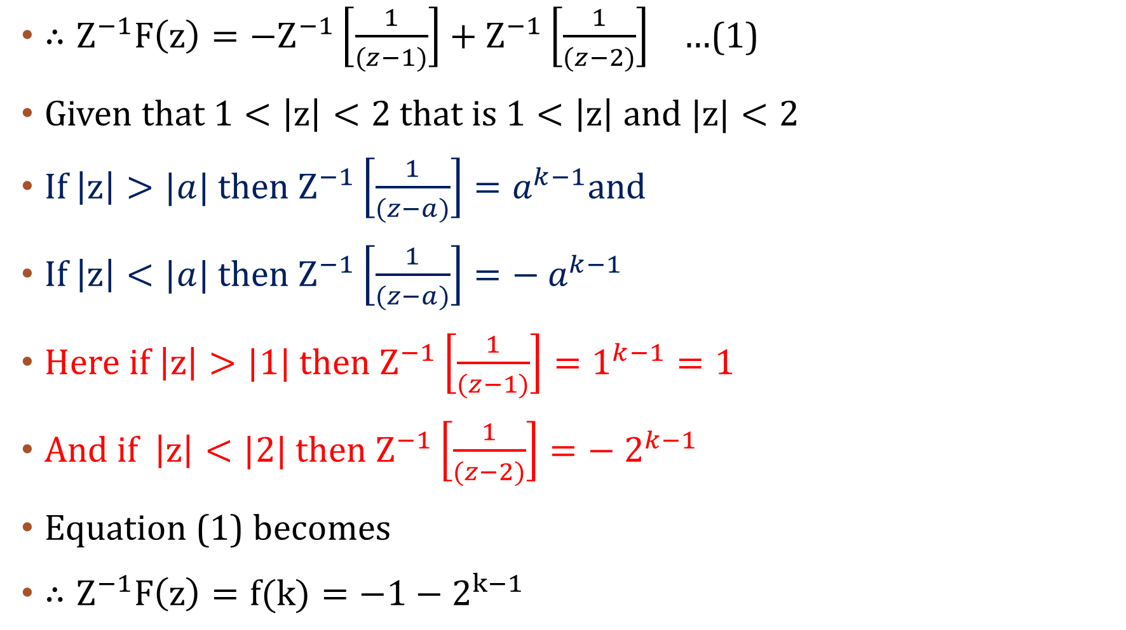
$∴Z^{−1}F\left(z\right)={−Z}^{−1}\left[\frac{1}{(z−1)}\right]+Z^{−1}\left[\frac{1}{(z−2)}\right]$ …(1)
Given that $1<\left|z\right|<2 that is 1<\left|z\right| and |z|<2$
If $\left|z\right|>|a|$ then $Z^{−1}\left[\frac{1}{(z−a)}\right]=a^{k−1}$and
If $\left|z\right|<|a|$ then $Z^{−1}\left[\frac{1}{(z−a)}\right]={− a}^{k−1}$
Here if $\left|z\right|>|1|$ then $Z^{−1}\left[\frac{1}{(z−1)}\right]=1^{k−1}=1$
And if $\left|z\right|<|2|$ then $Z^{−1}\left[\frac{1}{(z−2)}\right]={− 2}^{k−1}$
Equation (1) becomes
$∴Z^{−1}F\left(z\right)=f(k)=−1−2^{k−1}$

Slide 6
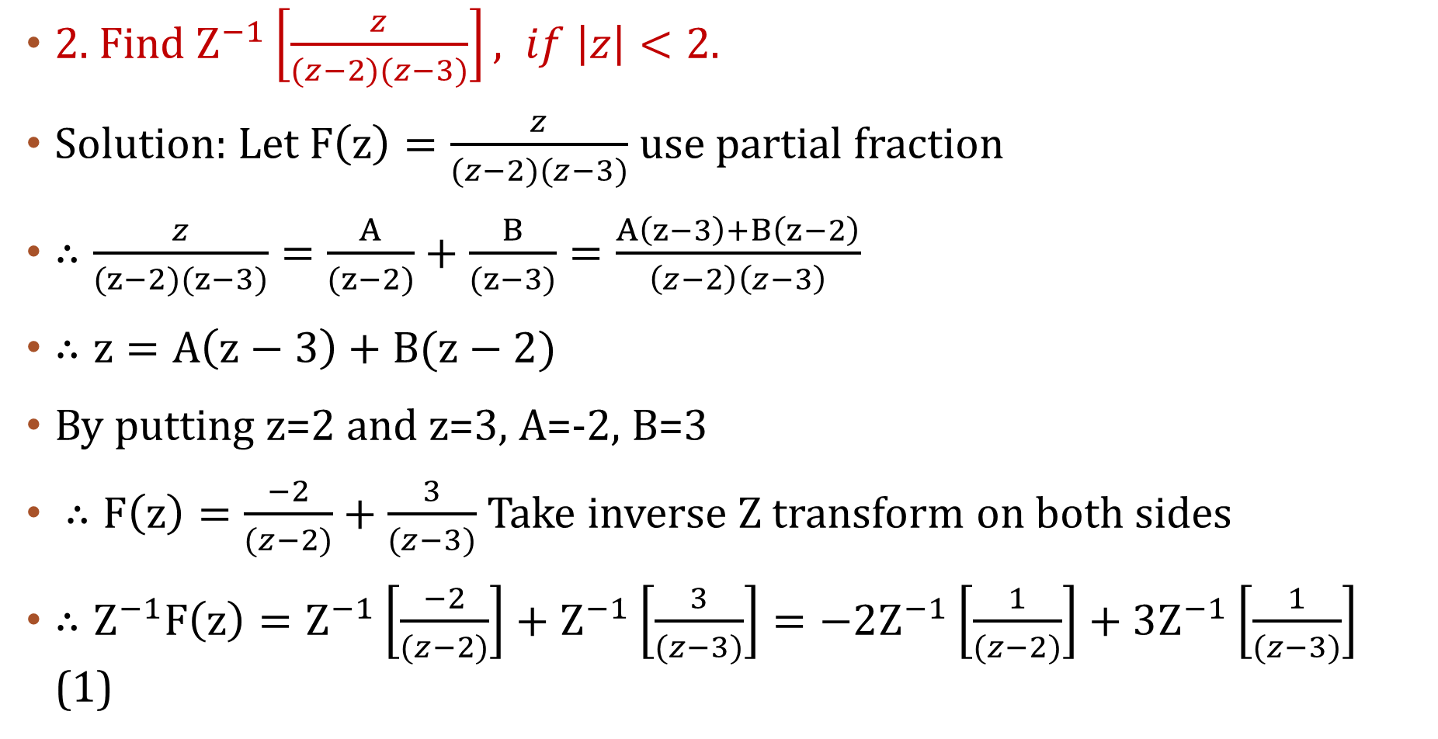
2. Find $Z^{−1}\left[\frac{z}{(z−2)(z−3)}\right], if \left|z\right|<2.$
Solution: Let $F\left(z\right)=\frac{z}{(z−2)(z−3)}$ use partial fraction
$∴\frac{z}{(z−2)(z−3)}=\frac{A}{(z−2)}+\frac{B}{(z−3)}=\frac{A\left(z−3\right)+B\left(z−2\right)}{\left(z−2\right)\left(z−3\right)}$
$∴z=A\left(z−3\right)+B(z−2)$
By putting z=2 and z=3, A=-2, B=3
$∴F\left(z\right)=\frac{−2}{(z−2)}+\frac{3}{(z−3)}$ Take inverse Z transform on both sides
$∴Z^{−1}F\left(z\right)=Z^{−1}\left[\frac{−2}{(z−2)}\right]+Z^{−1}\left[\frac{3}{(z−3)}\right]=−2Z^{−1}\left[\frac{1}{(z−2)}\right]+3Z^{−1}\left[\frac{1}{(z−3)}\right]$ (1)

Slide 7
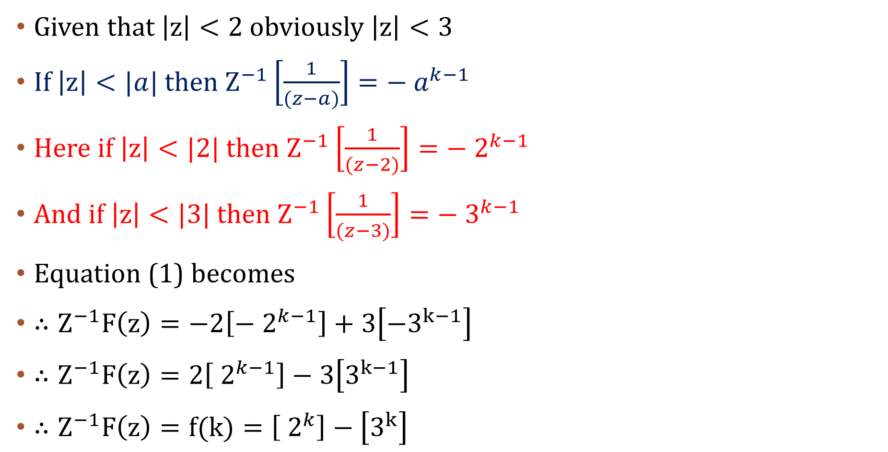
Given that $\left|z\right|<2$ obviously $\left|z\right|<3$
If $\left|z\right|<|a|$ then $Z^{−1}\left[\frac{1}{(z−a)}\right]={− a}^{k−1}$
Here if $\left|z\right|<|2|$ then $Z^{−1}\left[\frac{1}{(z−2)}\right]={− 2}^{k−1}$
And if $\left|z\right|<|3|$ then $Z^{−1}\left[\frac{1}{(z−3)}\right]={− 3}^{k−1}$
Equation (1) becomes
$∴Z^{−1}F\left(z\right)=−2\left[{− 2}^{k−1}\right]+3\left[−3^{k−1}\right]$
$∴Z^{−1}F\left(z\right)=2\left[{ 2}^{k−1}\right]−3\left[3^{k−1}\right]$
$∴Z^{−1}F\left(z\right)=f(k)=\left[{ 2}^{k}\right]−\left[3^{k}\right]$

Slide 8
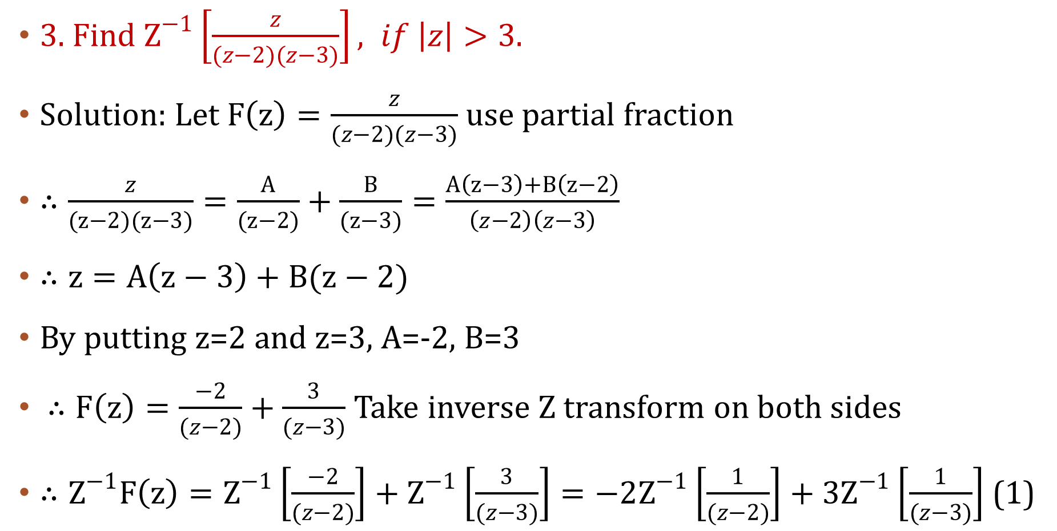
3. Find $Z^{−1}\left[\frac{z}{(z−2)(z−3)}\right], if \left|z\right|>3.$
Solution: Let $F\left(z\right)=\frac{z}{(z−2)(z−3)}$ use partial fraction
$∴\frac{z}{(z−2)(z−3)}=\frac{A}{(z−2)}+\frac{B}{(z−3)}=\frac{A\left(z−3\right)+B\left(z−2\right)}{\left(z−2\right)\left(z−3\right)}$
$∴z=A\left(z−3\right)+B(z−2)$
By putting z=2 and z=3, A=-2, B=3
$∴F\left(z\right)=\frac{−2}{(z−2)}+\frac{3}{(z−3)}$ Take inverse Z transform on both sides
$∴Z^{−1}F\left(z\right)=Z^{−1}\left[\frac{−2}{(z−2)}\right]+Z^{−1}\left[\frac{3}{(z−3)}\right]=−2Z^{−1}\left[\frac{1}{(z−2)}\right]+3Z^{−1}\left[\frac{1}{(z−3)}\right]$ (1)

Slide 9
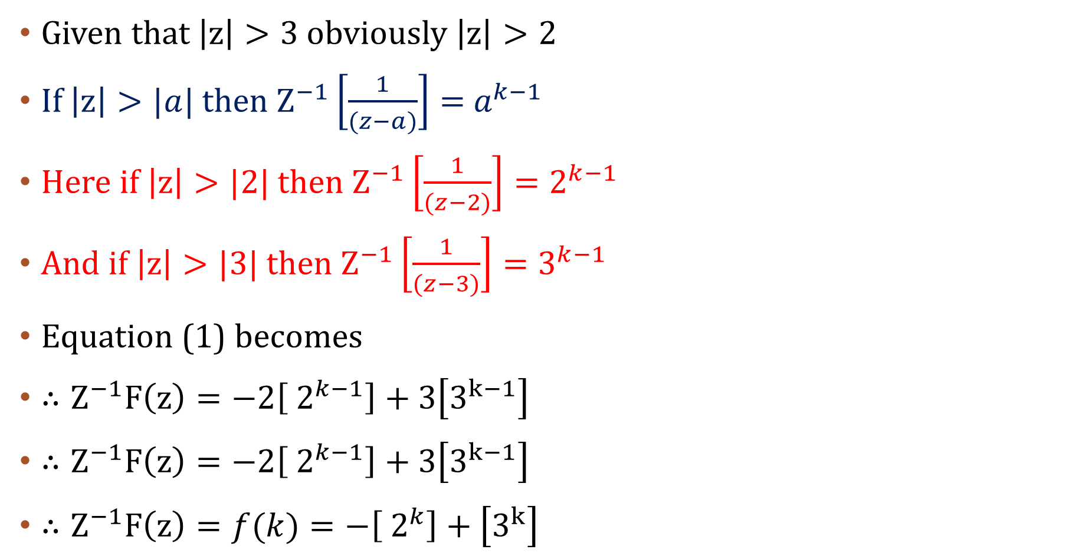
Given that $\left|z\right|>3$ obviously $\left|z\right|>2$
If $\left|z\right|>|a|$ then $Z^{−1}\left[\frac{1}{(z−a)}\right]={ a}^{k−1}$
Here if $\left|z\right|>|2|$ then $Z^{−1}\left[\frac{1}{(z−2)}\right]=2^{k−1}$
And if $\left|z\right|>|3|$ then $Z^{−1}\left[\frac{1}{(z−3)}\right]=3^{k−1}$
Equation (1) becomes
$∴Z^{−1}F\left(z\right)=−2\left[{ 2}^{k−1}\right]+3\left[3^{k−1}\right]$
$∴Z^{−1}F\left(z\right)=−2\left[{ 2}^{k−1}\right]+3\left[3^{k−1}\right]$
$∴Z^{−1}F\left(z\right)=f(k)=−\left[{ 2}^{k}\right]+\left[3^{k}\right]$

Slide 10
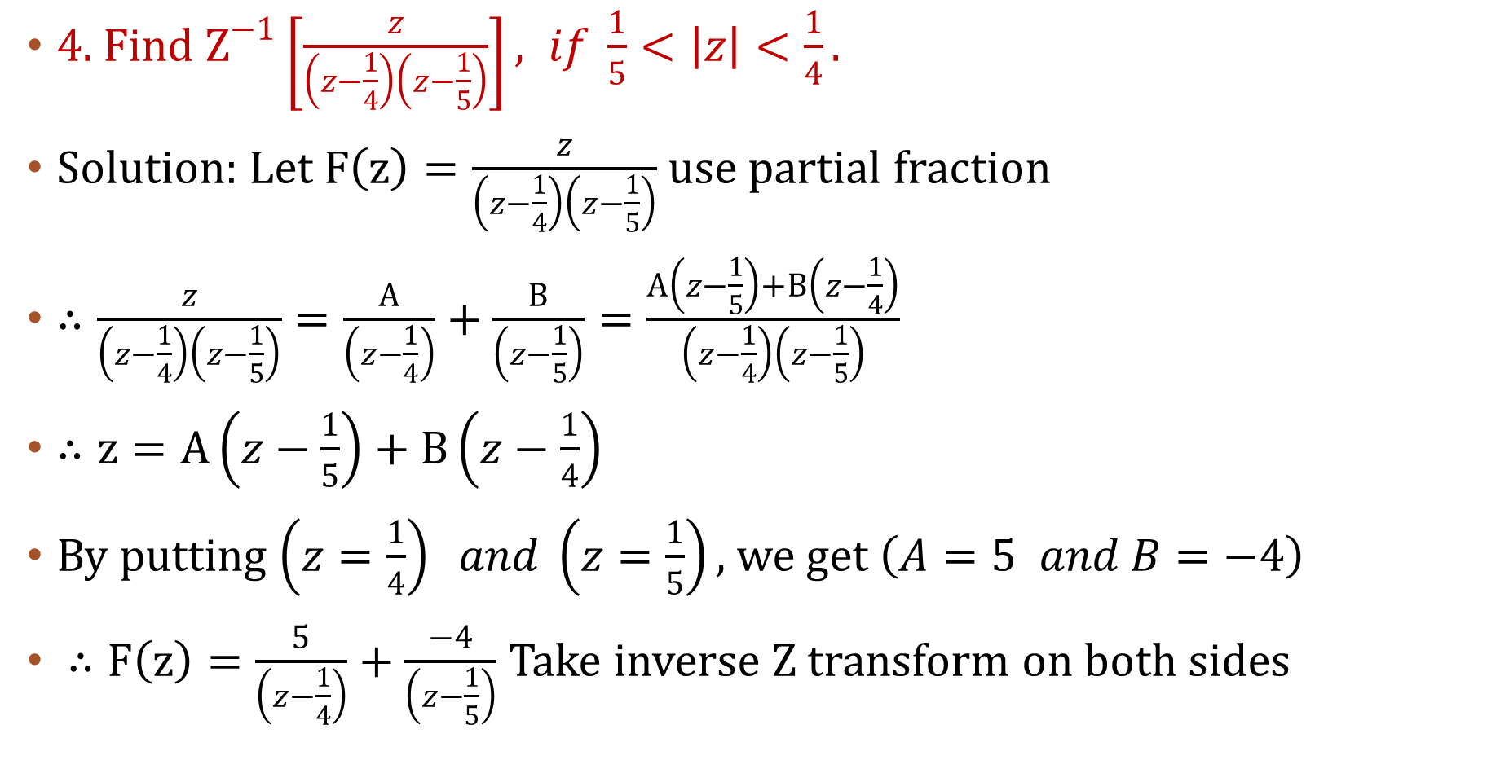
4. Find $Z^{−1}\left[\frac{z}{\left(z−\frac{1}{4}\right)\left(z−\frac{1}{5}\right)}\right], if \frac{1}{5}<\left|z\right|<\frac{1}{4}.$
Solution: Let $F\left(z\right)=\frac{z}{\left(z−\frac{1}{4}\right)\left(z−\frac{1}{5}\right)}$ use partial fraction
$∴\frac{z}{\left(z−\frac{1}{4}\right)\left(z−\frac{1}{5}\right)}=\frac{A}{\left(z−\frac{1}{4}\right)}+\frac{B}{\left(z−\frac{1}{5}\right)}=\frac{A\left(z−\frac{1}{5}\right)+B\left(z−\frac{1}{4}\right)}{\left(z−\frac{1}{4}\right)\left(z−\frac{1}{5}\right)}$
$∴z=A\left(z−\frac{1}{5}\right)+B\left(z−\frac{1}{4}\right)$
By putting $\left(z=\frac{1}{4}\right) and \left(z=\frac{1}{5}\right),$ we get $\left(A=5 and B=−4\right)$
$∴F\left(z\right)=\frac{5}{\left(z−\frac{1}{4}\right)}+\frac{−4}{\left(z−\frac{1}{5}\right)}$ Take inverse Z transform on both sides

Slide 11
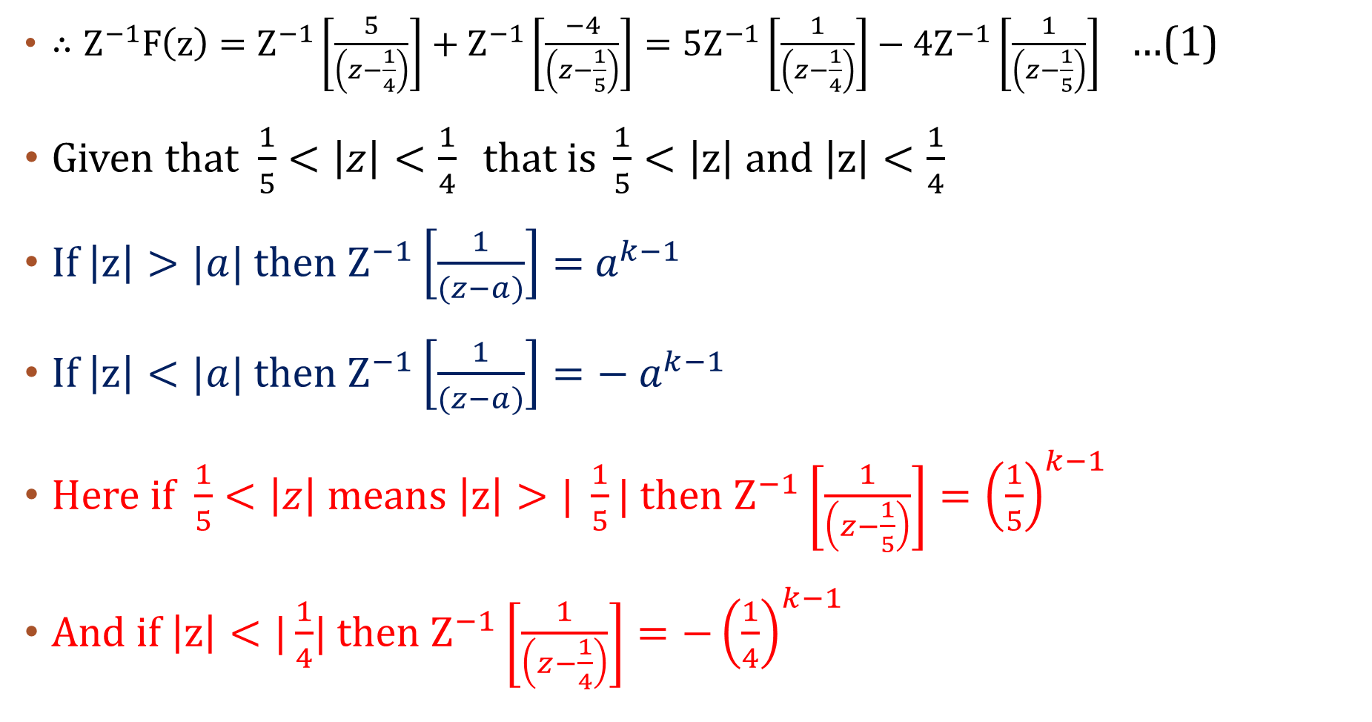
$∴Z^{−1}F\left(z\right)=Z^{−1}\left[\frac{5}{\left(z−\frac{1}{4}\right)}\right]+Z^{−1}\left[\frac{−4}{\left(z−\frac{1}{5}\right)}\right]=5Z^{−1}\left[\frac{1}{\left(z−\frac{1}{4}\right)}\right]−4Z^{−1}\left[\frac{1}{\left(z−\frac{1}{5}\right)}\right]$ …(1)
Given that $\frac{1}{5}<\left|z\right|<\frac{1}{4} that is \frac{1}{5}<\left|z\right| and \left|z\right|<\frac{1}{4}$
If $\left|z\right|>|a|$ then $Z^{−1}\left[\frac{1}{(z−a)}\right]={ a}^{k−1}$
If $\left|z\right|<|a|$ then $Z^{−1}\left[\frac{1}{(z−a)}\right]=−{ a}^{k−1}$
Here if $\frac{1}{5}<\left|z\right| means \left|z\right|>| \frac{1}{5}|$ then $Z^{−1}\left[\frac{1}{\left(z−\frac{1}{5}\right)}\right]={\left(\frac{1}{5}\right)}^{k−1}$
And if $\left|z\right|<|\frac{1}{4}$| then $Z^{−1}\left[\frac{1}{\left(z−\frac{1}{4}\right)}\right]=−{\left(\frac{1}{4}\right)}^{k−1}$

Slide 12
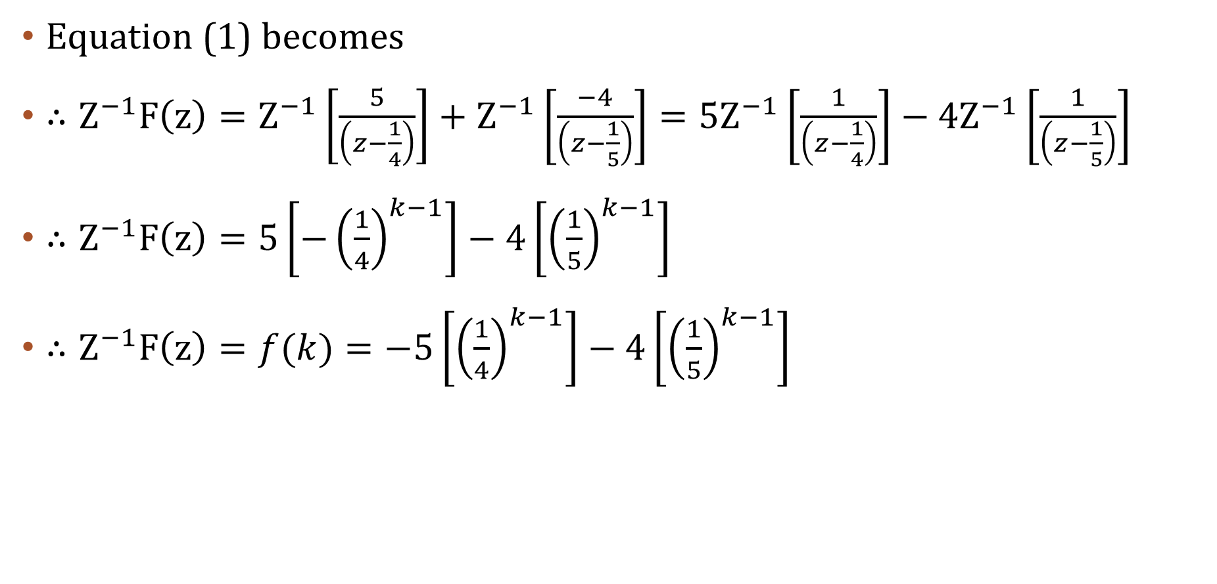
Equation (1) becomes
$∴Z^{−1}F\left(z\right)=Z^{−1}\left[\frac{5}{\left(z−\frac{1}{4}\right)}\right]+Z^{−1}\left[\frac{−4}{\left(z−\frac{1}{5}\right)}\right]=5Z^{−1}\left[\frac{1}{\left(z−\frac{1}{4}\right)}\right]−4Z^{−1}\left[\frac{1}{\left(z−\frac{1}{5}\right)}\right]$
$∴Z^{−1}F\left(z\right)=5\left[−{\left(\frac{1}{4}\right)}^{k−1}\right]−4\left[{\left(\frac{1}{5}\right)}^{k−1}\right]$
$∴Z^{−1}F\left(z\right)=f(k)=−5\left[{\left(\frac{1}{4}\right)}^{k−1}\right]−4\left[{\left(\frac{1}{5}\right)}^{k−1}\right]$

Slide 13
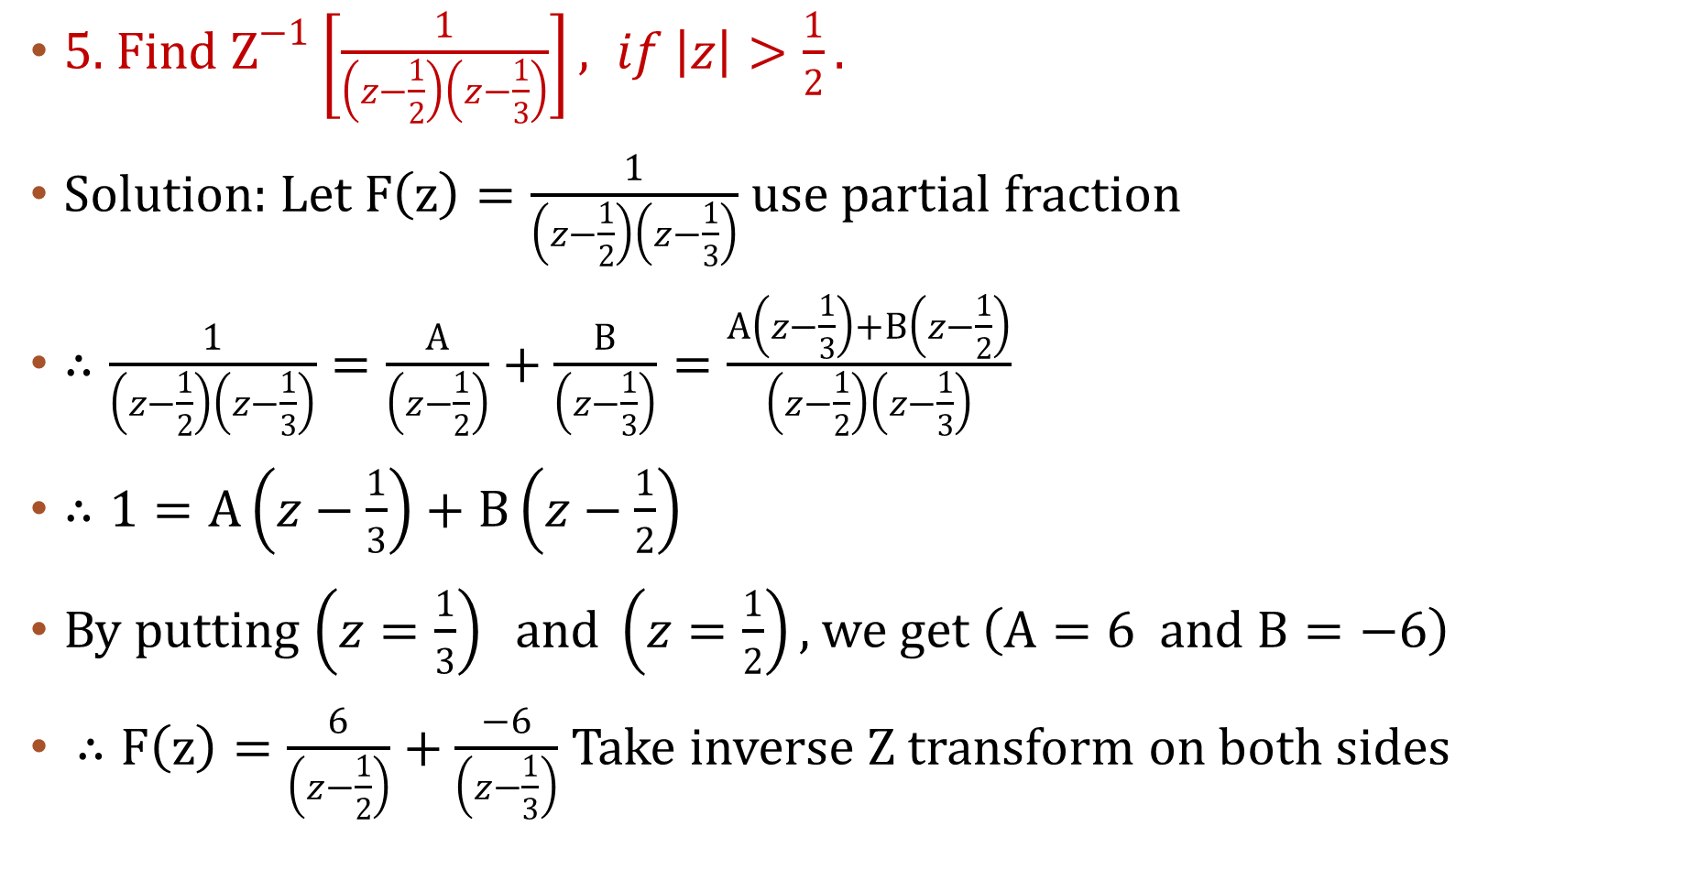
5. Find $Z^{−1}\left[\frac{1}{\left(z−\frac{1}{2}\right)\left(z−\frac{1}{3}\right)}\right], if \left|z\right|>\frac{1}{2}.$
Solution: Let $F\left(z\right)=\frac{1}{\left(z−\frac{1}{2}\right)\left(z−\frac{1}{3}\right)}$ use partial fraction
$∴\frac{1}{\left(z−\frac{1}{2}\right)\left(z−\frac{1}{3}\right)}=\frac{A}{\left(z−\frac{1}{2}\right)}+\frac{B}{\left(z−\frac{1}{3}\right)}=\frac{A\left(z−\frac{1}{3}\right)+B\left(z−\frac{1}{2}\right)}{\left(z−\frac{1}{2}\right)\left(z−\frac{1}{3}\right)}$
$∴1=A\left(z−\frac{1}{3}\right)+B\left(z−\frac{1}{2}\right)$
By putting $\left(z=\frac{1}{3}\right) and \left(z=\frac{1}{2}\right),$ we get $\left(A=6 and B=−6\right)$
$∴F\left(z\right)=\frac{6}{\left(z−\frac{1}{2}\right)}+\frac{−6}{\left(z−\frac{1}{3}\right)}$ Take inverse Z transform on both sides

Slide 14
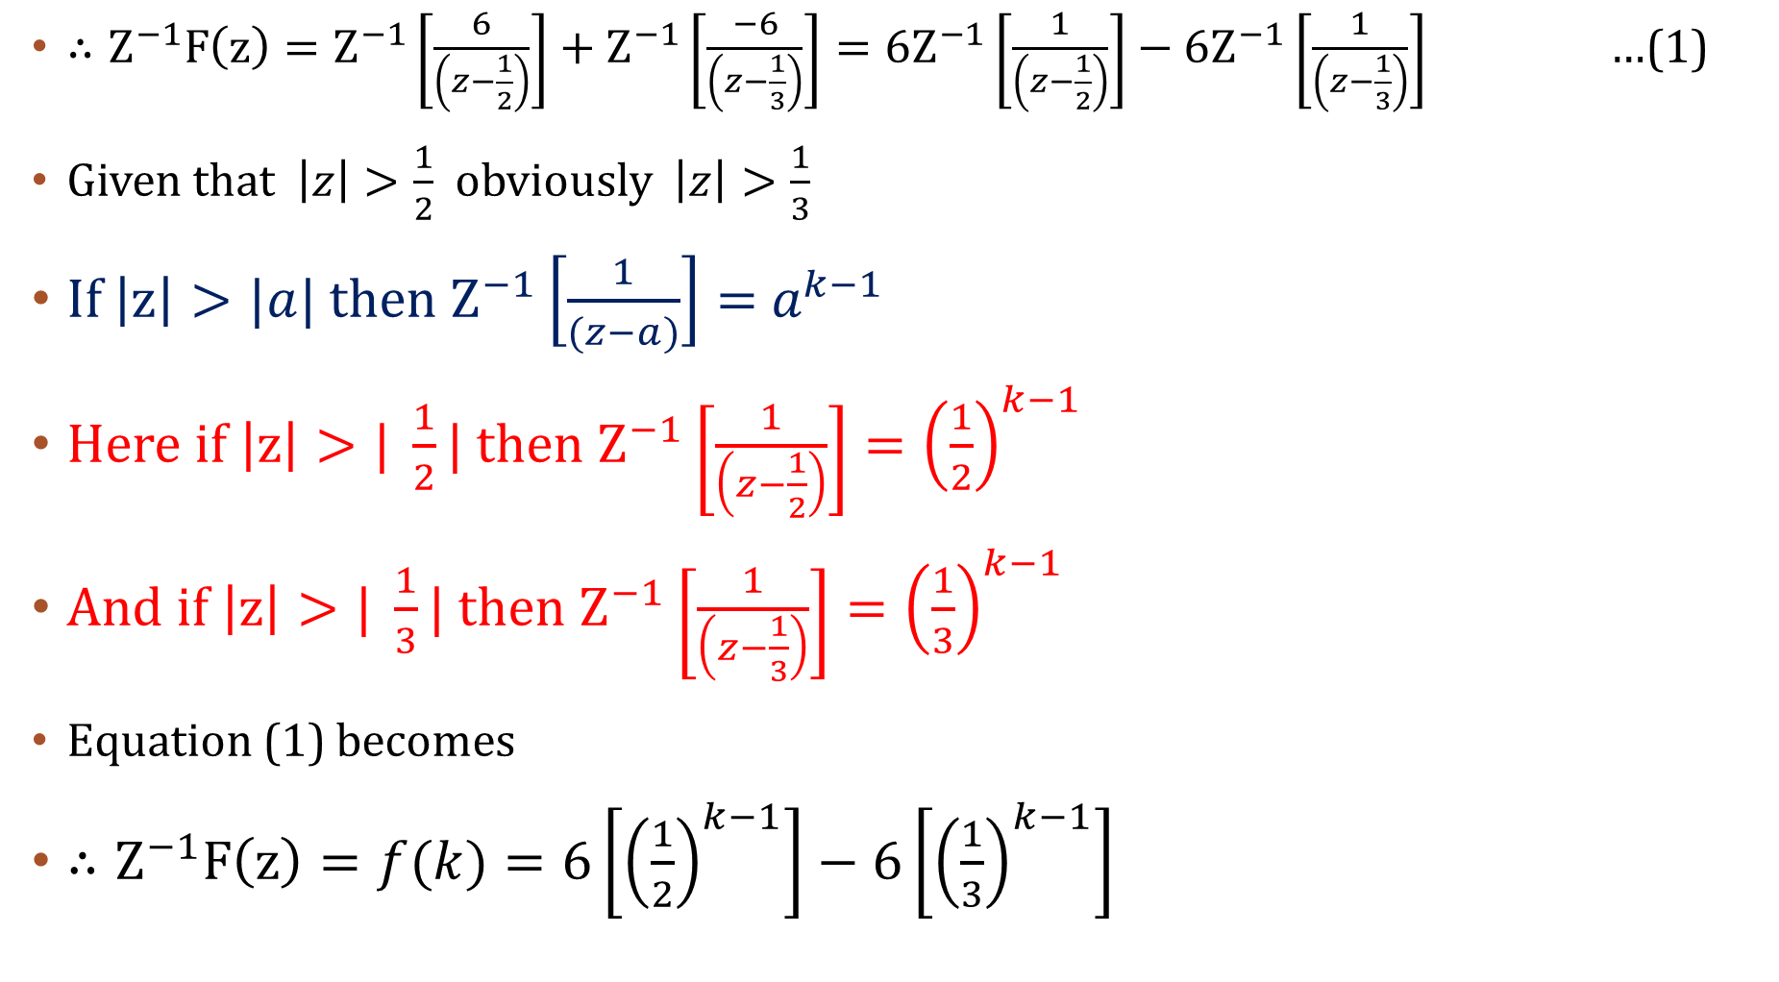
$∴Z^{−1}F\left(z\right)=Z^{−1}\left[\frac{6}{\left(z−\frac{1}{2}\right)}\right]+Z^{−1}\left[\frac{−6}{\left(z−\frac{1}{3}\right)}\right]=6Z^{−1}\left[\frac{1}{\left(z−\frac{1}{2}\right)}\right]−6Z^{−1}\left[\frac{1}{\left(z−\frac{1}{3}\right)}\right]$ …(1)
Given that $\left|z\right|>\frac{1}{2}$ obviously $\left|z\right|>\frac{1}{3}$
If $\left|z\right|>|a|$ then $Z^{−1}\left[\frac{1}{(z−a)}\right]={ a}^{k−1}$
Here if $\left|z\right|>| \frac{1}{2}|$ then $Z^{−1}\left[\frac{1}{\left(z−\frac{1}{2}\right)}\right]={\left(\frac{1}{2}\right)}^{k−1}$
And if $\left|z\right|>| \frac{1}{3}|$ then $Z^{−1}\left[\frac{1}{\left(z−\frac{1}{3}\right)}\right]={\left(\frac{1}{3}\right)}^{k−1}$
Equation (1) becomes
$∴Z^{−1}F\left(z\right)=f(k)=6\left[{\left(\frac{1}{2}\right)}^{k−1}\right]−6\left[{\left(\frac{1}{3}\right)}^{k−1}\right]$

